Slide 1
COMP 918: Research Administration for Scientists
The Federal Budgetary Process, Federal Funding for Research and UNC’s Share!
  Tim Quigg, Lecturer and Associate Chair for Administration, Finance and Entrepreneurship Computer Science Department, UNC-Chapel Hill
© Copyright 2013 Timothy L. Quigg All Rights Reserved

Slide 2
The U.S. Federal Budget
How does the budgeting process work? Where does the money go? And why should you care?
These are important questions for any citizen, but they are especially significant for anyone interested in federal support for research.

Slide 3
First, it’s a lot of money and it used to be yours!
    The federal government spends almost $4 trillion a year, 1/5 of the U.S. economy.
    More than 80 percent of the money comes directly from YOU through income taxes, payroll taxes and
borrowing!

Slide 4
Second, it’s not possible to “do” policy in Washington without money!
    Bills can be passed, but without money policies can’t be implemented.
    In these times of huge budget deficits, every program and expenditure has to be considered in the context of its impact on the budget.

Slide 5
Third, the budget process consumes much time and effort in Washington!
    The Government is always involved with three budget years at a time:
        Current year appropriations are being “spent.”
        The next year’s budget has been “proposed” by the President and is being “disposed” by the Congress - budget resolutions, hearings, passage of 12 separate appropriations bills.
        Federal agencies and OMB are working on the following year budget requests.

Slide 6
FY 1999
FY 2000
FY 2001

Slide 7
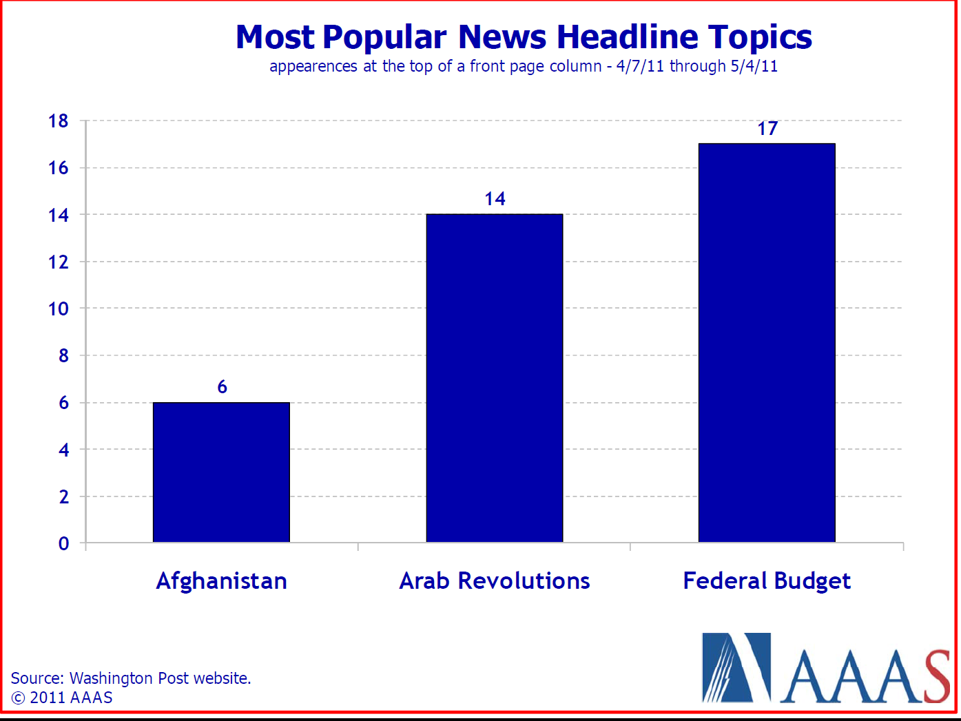
Fourth, the media is obsessed with covering the budget and deficit!

Slide 8
Finally, the federal budget determines the health of US science!
    The federal government spends ~ $150 billion a year on R&D.
    It funds nearly 75% of university research and supports fellowships, scholarships, student loans, and other aid.
    R&D funding is within the discretionary portion of the federal budget, thus it is the most vulnerable to cuts!

Slide 9
    There is no better way to measure the priorities of an organization than to examine where the organization spends its money.
    So always look at the budget to see what an organization really values!
    We’ll look at the federal budget in a few moments, but first…

Slide 10
    There is no better way to measure the priorities of an organization than to examine where the organization spends its money.
    So always look at the budget to see what an organization really values!
    Let’s look at the federal budgeting process to see how it works!
Well, how it “sort of” works!

Slide 11
Executive Office of the President (EXOP)
White House Office
Office of
Management & Budget
(OMB)
Office of the
Vice President
(OVP)
President’s Foreign Intelligence Advisory Board (PFIAB)
US Trade Representative
(USTR)
Office of
Policy Development
(OPD)
National Security Council (NSC)
Office of
Administration
(OA)
Council of
Economic Advisors
(CEA)
Office of National Drug Control Policy (ONDCP)
Primarily career staff
Council of
Environmental Quality
(CEQ)
Office of Science & Technology Policy (OSTP)
Political
Mix of detailees, career, political

Slide 12
The Budget Process
Department of Energy
White House
OMB
Science
Fossil
Energy
NNSA
Congress
House
Senate
Approps
Approps

Slide 13
The Budget Process
Department of Energy
White House
Guidance
OMB
Science
Fossil
Energy
NNSA

Slide 14
The Budget Process
Department of Energy
Science
Fossil
Energy
NNSA

Slide 15
The Budget Process
Department of Energy
White House
OMB
Science
Fossil
Energy
NNSA
Budget Request

Slide 16
The Budget Process
Department of Energy
White House
Passback
OMB
Science
Fossil
Energy
NNSA
Budget Request

Slide 17
The Budget Process
Department of Energy
White House
Appeal
Passback
OMB
Science
Fossil
Energy
NNSA
Budget Request

Slide 18
The Budget Process
Department of Energy
White House
OMB
Science
Fossil
Energy
NNSA
Congress
President’s
Budget Request
House
Senate
Approps
Approps

Slide 19
The Budget Process
Department of Energy
White House
OMB
Science
Fossil
Energy
NNSA
Congress
Budget Resolution
302(b) Allocation
Subcommittee Markup
Committee Markup
Floor Vote
Conference
House
Senate
Approps
Approps

Slide 20
The Budget Process
Department of Energy
White House
OMB
Science
Fossil
Energy
NNSA
SAPs
Congress
Budget Resolution
302(b) Allocation
Subcommittee Markup
Committee Markup
Floor Vote
Conference
House
Senate
Approps
Approps

Slide 21
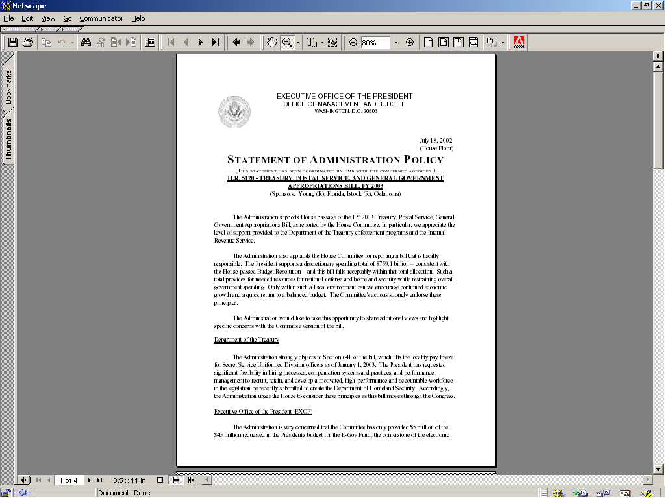

Slide 22
The Budget Process
Department of Energy
White House
OMB
Science
Fossil
Energy
NNSA
Congress
Hearings
Budget Resolution
302(b) Allocation
Subcommittee Markup
Committee Markup
Floor Vote
Conference
House
Senate
Approps
Approps

Slide 23
The Budget Process
Department of Energy
White House
OMB
Science
Fossil
Energy
NNSA
Bills
Congress
House
Senate
Approps
Approps

Slide 24
The Budget Process
Department of Energy
White House
Apportionment
OMB
Science
Fossil
Energy
NNSA
$
Congress
House
Senate
Approps
Approps

Slide 25
Glossary of Federal Budget Terms
Gross Domestic Product (GDP): The value of all finished goods and services produced in a country during a given period - usually a fiscal year. GDP serves as the principal measure of the size of a country’s economy.
Fiscal Year: The federal government’s accounting period which begins October 1 and ends September 30. Most state government fiscal years, including North Carolina, run from July 1 to June 30.

Slide 26
Glossary of Federal Budget Terms
Congressional Budget Office (CBO): A non-partisan legislative agency that assists Congress in preparing and analyzing all budget-related issues. The CBO is responsible for estimating the budgetary effects of all spending and revenue bills, commonly called a “mark-up” or “scoring a bill.”
Office of Management and Budget (OMB): An executive agency located in the White House that prepares the President’s budget for submission to Congress, manages the distribution and expenditure of appropriated funds, and distributes budget and spending rules applicable to all federal agencies.

Slide 27
Glossary of Federal Budget Terms
Authorization: Legislation that either establishes or continues a federal program or agency, specifies its general goals and conduct, and sets a ceiling for the amount of money that can later be appropriated. Total accumulated appropriations may not exceed the amount authorized for a given program, but Congress is under no obligation to fully or even partially fund any program.
Appropriation: The amount of funding Congress provides for a federal program to spend in a given fiscal year. The appropriation bill may also set the terms under which the funds may be spent.

Slide 28
Glossary of Federal Budget Terms
Sequestration: The Congressional Research Service defines sequestration as “the permanent cancellation of budgetary resources by a uniform percentage. This uniform percentage reduction is applied to all programs, projects, and activities within a budget account.”
Authority for sequestration can come from either the Balanced Budget and Emergency Deficit Control Act of 1985 or the Pay As You Go Act of 2010. In the later case, the federal government must continue to pay Social Security, unemployment and veterans benefits, Medicaid, food stamps and Supplemental Security Income. Medicare is subject to automatic cuts under sequestration authorized by this bill. However, reductions cannot be more than 2 percent.

Slide 29
Glossary of Federal Budget Terms
Continuing Resolution (CR): Legislation that extends appropriations for specific ongoing programs when the regular appropriation bills have not been enacted by the beginning of the fiscal year - October 1. A CR may authorize spending at the previous year’s level or at some percentage increase or decrease. It is intended to cover a brief period (weeks) to provide time for Congress to complete work on the new budget. However due to their inability to approve new budgets, Congress has passed many consecutive CRs in recent years.

Slide 30
Glossary of Federal Budget Terms
Discretionary Programs: Programs funded by one of twelve (12) annual congressional appropriation bills - currently about 1/3rd of the federal budget.
Discretionary Spending Cap: A self-imposed limit that Congress places on the total amount of budget authority and outlay for all discretionary programs in a given fiscal year.

Slide 31
Glossary of Federal Budget Terms
Earmarks: Often referred to as “pork” these are appropriations that fund specific projects, e.g., a new research center at a university or a bridge in a particular state. Earmarks by-pass the normal process within an agency for determining what projects to fund - in the case of science, by peer review. The cost of earmarks are often charged against the agency’s appropriation, thus limiting the funds available for projects through the agency’s normal funding process.

Slide 32
Glossary of Federal Budget Terms
Hard Earmarks: Contained in legislative text, therefore they are required by law.
Soft Earmarks: Contained in a Congressional committee report only, therefore they are not required by law.
  Not binding, but customarily acted upon.
  Most earmarks are soft earmarks - not as easily traceable to a specific Congressman.
  FY 2010 there were 9,192 soft earmarks for a total of $11.1 billion.

Slide 33
Glossary of Federal Budget Terms
Entitlement: A program which mandates the payment of benefits to any person meeting certain eligibility requirements established by statute. Therefore, the total amount spent is determined by the number of people applying for and meeting the eligibility requirements, not by annual congressional appropriations. Entitlement programs include Social Security, Medicare and Medicaid.

Slide 34
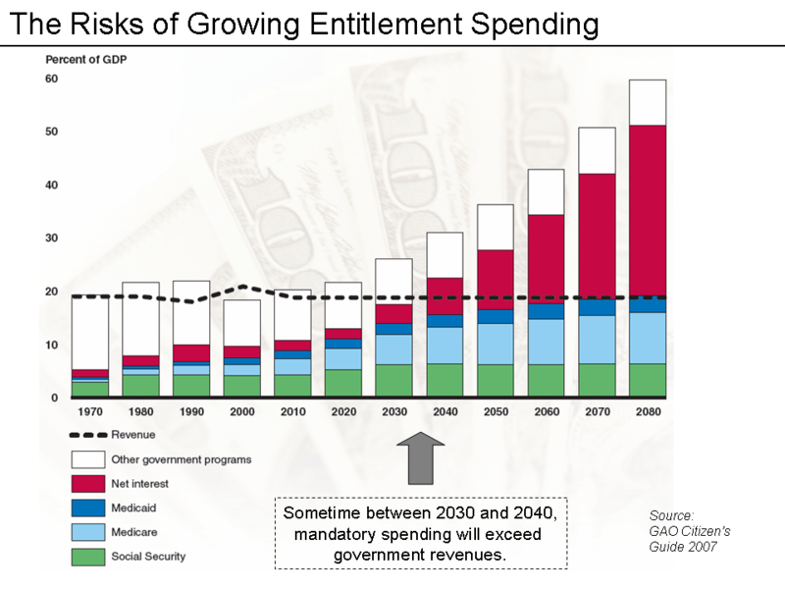
What is mandatory spending?

Slide 35
Combined spending on entitlement programs and the national debt!

Slide 36
Mandatory spending is now almost 2/3rds (and rising) of all federal spending!

Slide 37
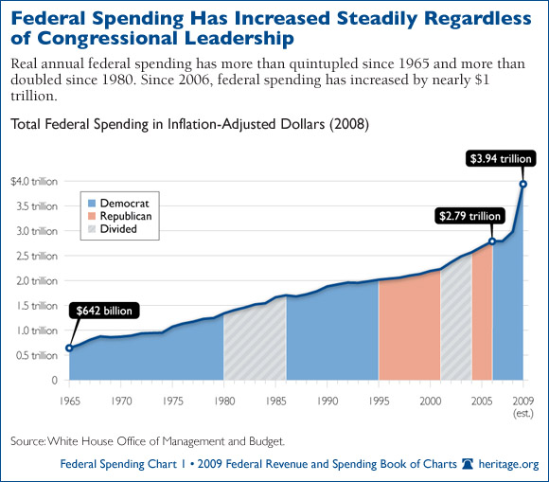

Slide 38
Glossary of Federal Budget Terms
Deficit: The amount by which the government’s spending exceeds its revenues in a single fiscal year. In 2011 nearly 40 cents of every dollar spent was borrowed!
Unified Deficit: The most commonly used measure of the federal deficit, it includes all federal spending and all federal revenues.
Federal Funds Ceiling: A measure of the federal deficit that excludes the spending and revenue from federal government trust funds such as Social Security.

Slide 39
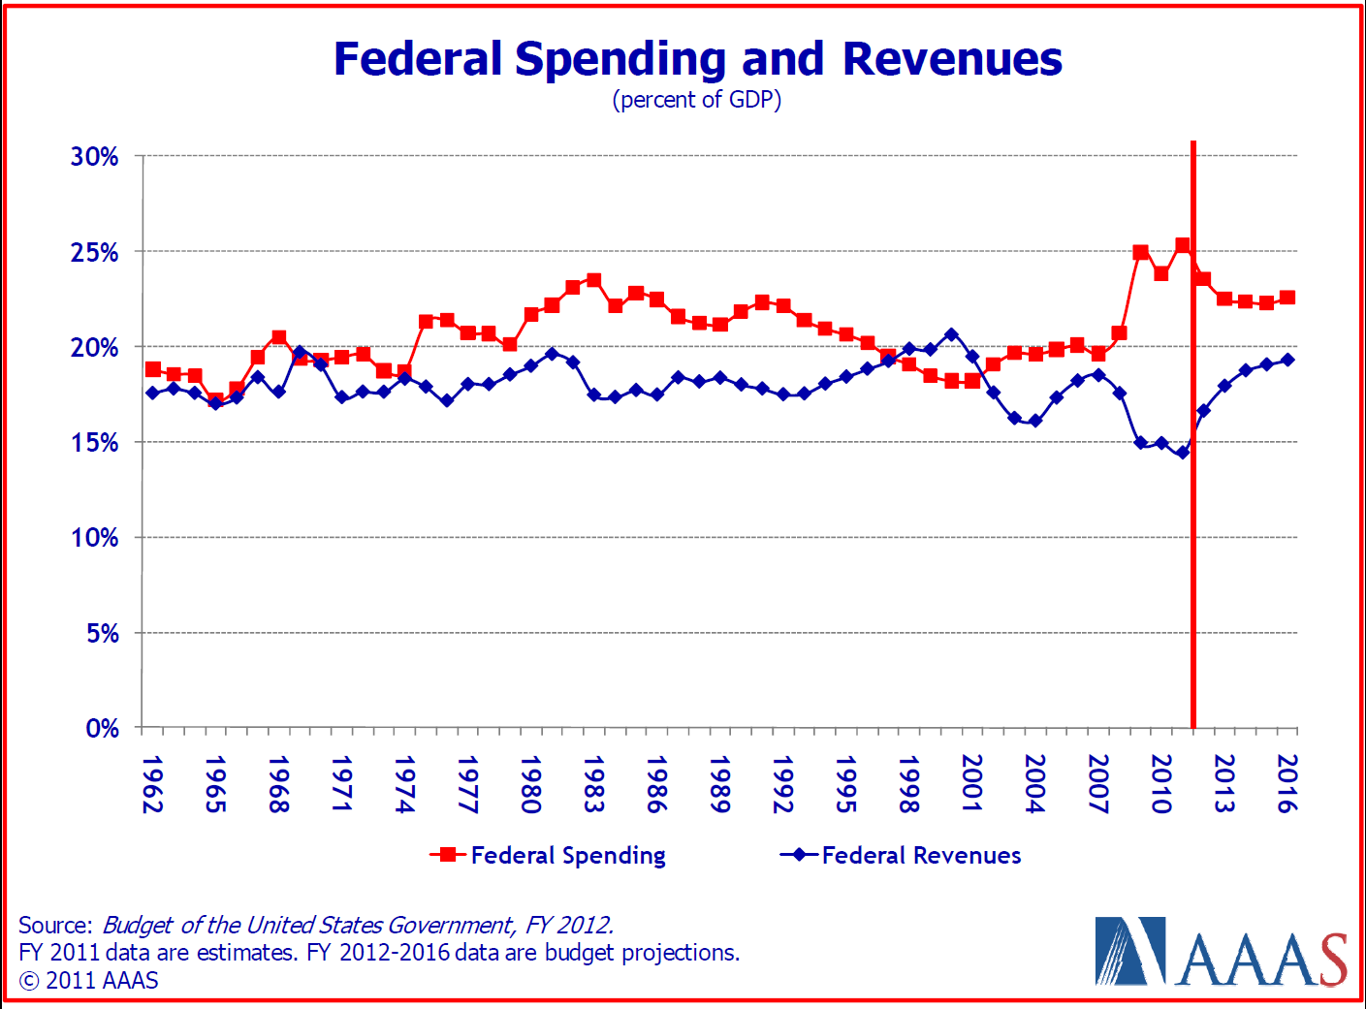

Slide 40
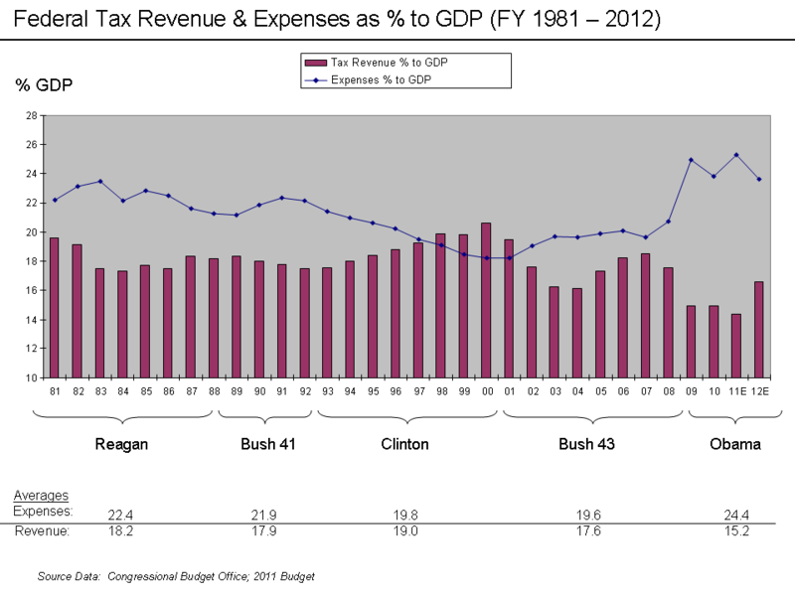

Slide 41
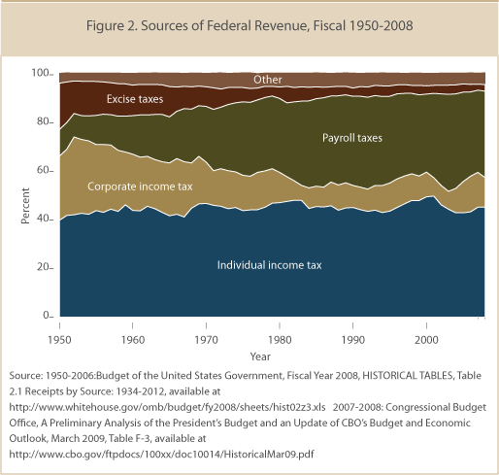

Slide 42
Glossary of Federal Budget Terms
Debt: The total accumulated amount of money the federal government has borrowed and not paid back from President Washington to President Obama - currently over $16 trillion.
Treasury Bills: The government “borrows” by selling T-bills which pay interest and mature on specific future dates. Example – one might purchase a $100 T-bill for $92. At a specified date in the future the T-bill will mature and be redeemable for $100. The government normally pays-off maturing T-bills with cash derived from issuing new T-bills!

Slide 43
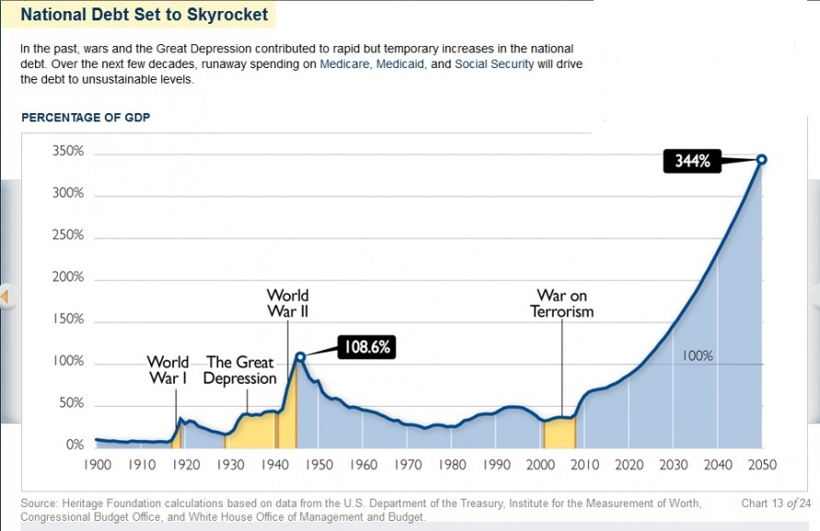

Slide 44
Debt Ceiling: A statutory limit imposed on the total allowable federal debt. The ceiling can only be raised by an act of Congress.
If Congress fails to raise the debt ceiling before it is exceeded by debt obligations, the U.S. Treasury would neither have adequate funds to meet the government’s obligations nor would it have the authority to borrow additional funds. This would result in default by the federal government – a situation which has never occurred!

Slide 45
Debt Ceiling: A statutory limit imposed on the total allowable federal debt. The ceiling can only be raised by an act of Congress.
Think of the debt ceiling as the borrowing limit on a credit card!
And you’re only allowed to have one credit card!

Slide 46
Debt Held by the Public: Federal debt held by all investors outside the federal government including individuals, corporations, state and local governments, the Federal Reserve banking system, and foreign governments. When the debt held by the Federal Reserve is excluded, the remaining amount is referred to as privately held debt.
Debt Held by Government Accounts: Federal debt held by the federal government itself. Most of this debt is held by trust funds, such as Social Security.
Gross Debt: The total amount of outstanding federal debt whether issued by the Treasury or by other agencies and held by either the public or by federal government accounts.

Slide 47
Debt-to-GDP Ratio: A useful measure of a country’s debt in relation to its GDP. It compares what a country owes (cumulative) to what it produces (within a year), and is used as an indication of a country’s ability to service its debt.
Russia 9%
Saudi Arabia 9%
Mexico 38%
China 44%
India 52
Brazil 55%
Israel 74%
EU 83%
Germany 85%
United Kingdom 87%
United States 105%
Ireland 108%
Singapore 118%
Italy 120%
Iceland 130%
Greece 165%
Japan 208%
Zimbabwe 231%
2011 Debt-to-GDP Ratios for Selected Countries

Slide 48
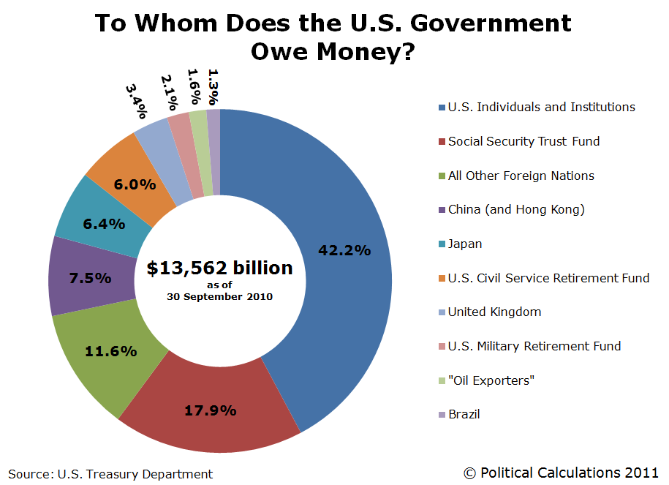
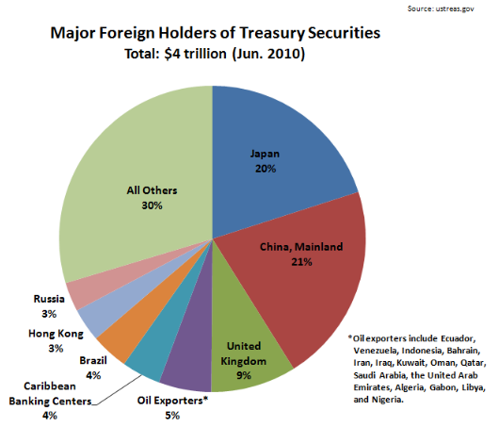

Slide 49
FY 2012 Budget Overview
Mandatory
Social Security 20.5%
Medicare 13.0%
Medicaid 7.0%
Other (VA, Federal 16.0%
Retirement, etc.)
Interest on debt 7.0%
Subtotal 63.5%
Discretionary
Defense 20.0% *
Non-defense 16.5% *
Subtotal 36.5%
* ~ 2% is for R&D (4% of total federal expenditures)

Slide 50
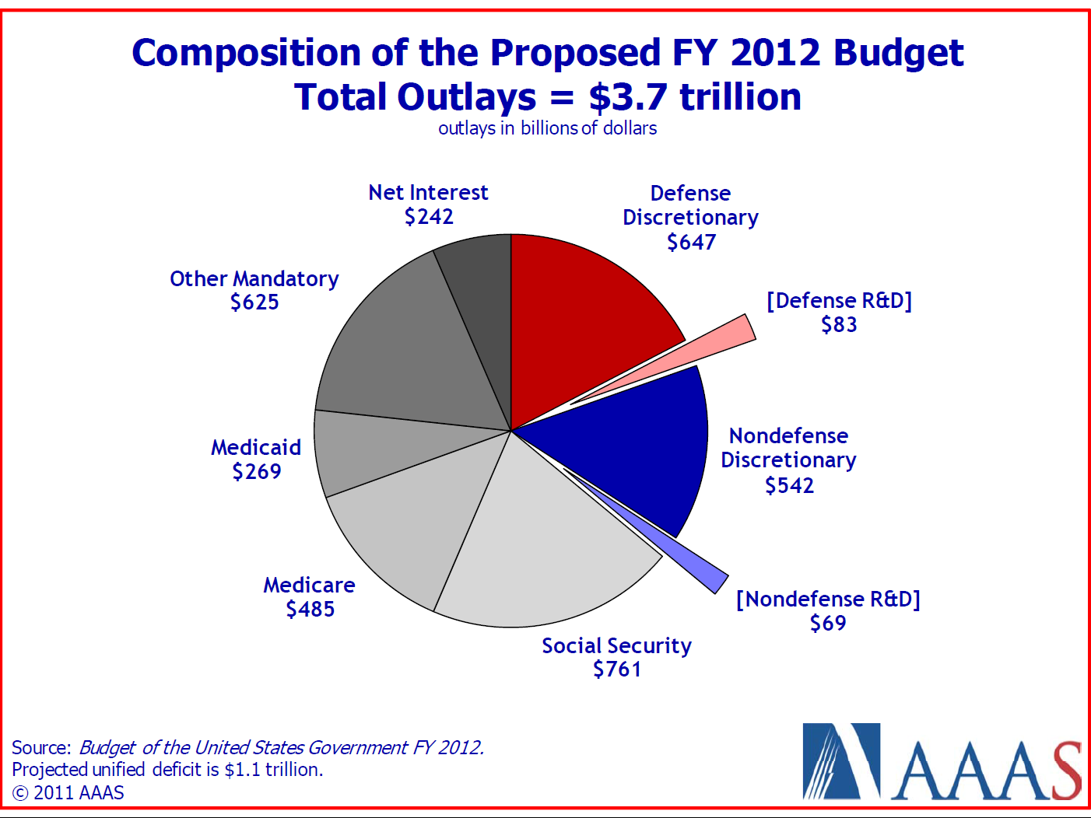

Slide 51
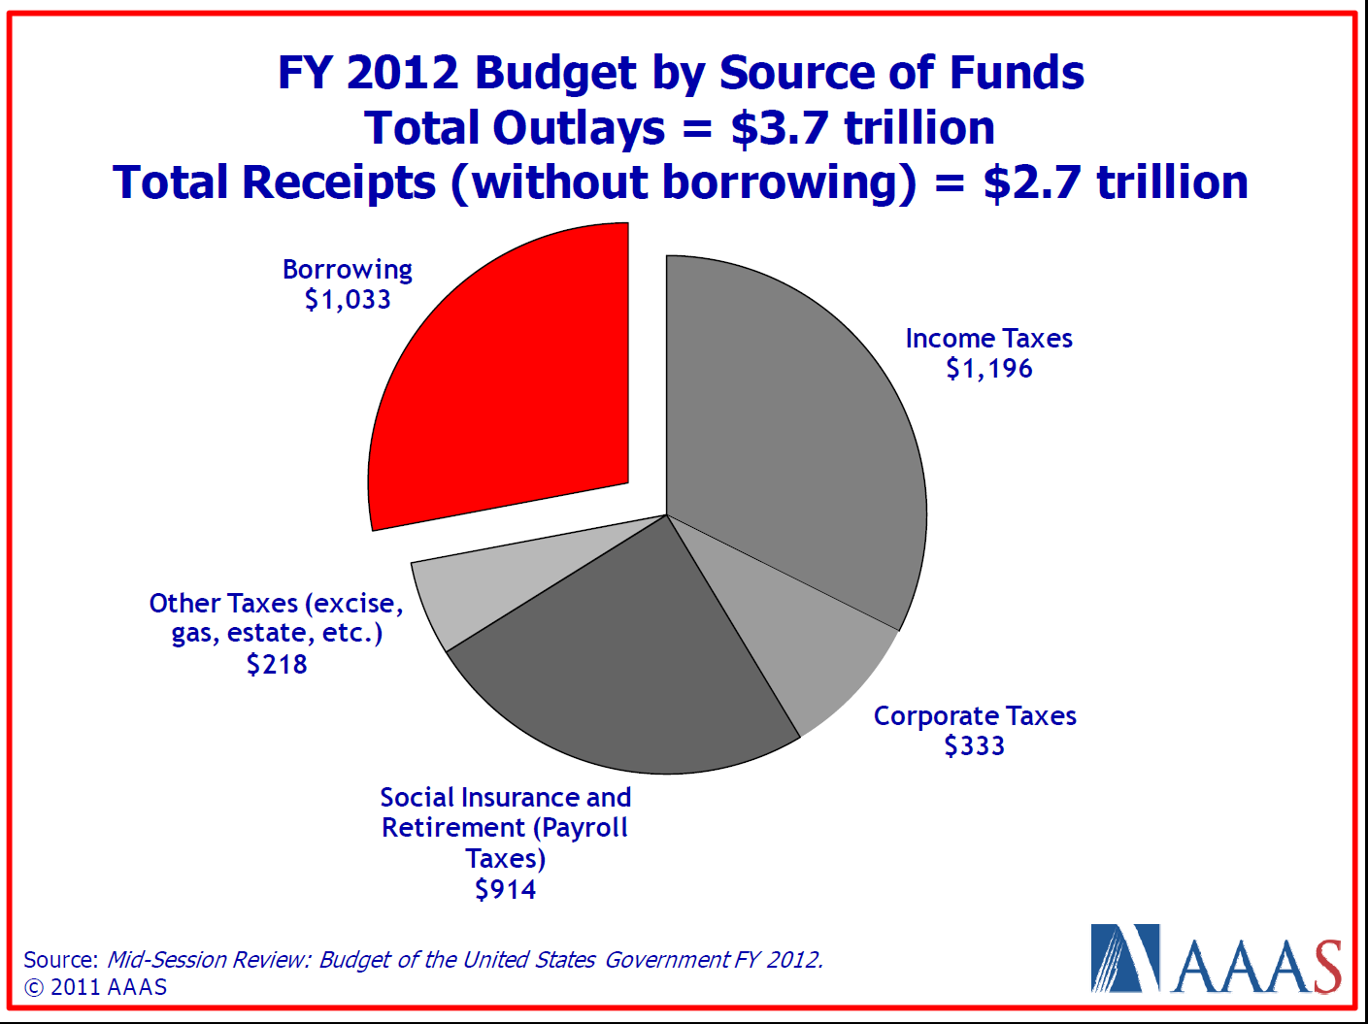

Slide 52
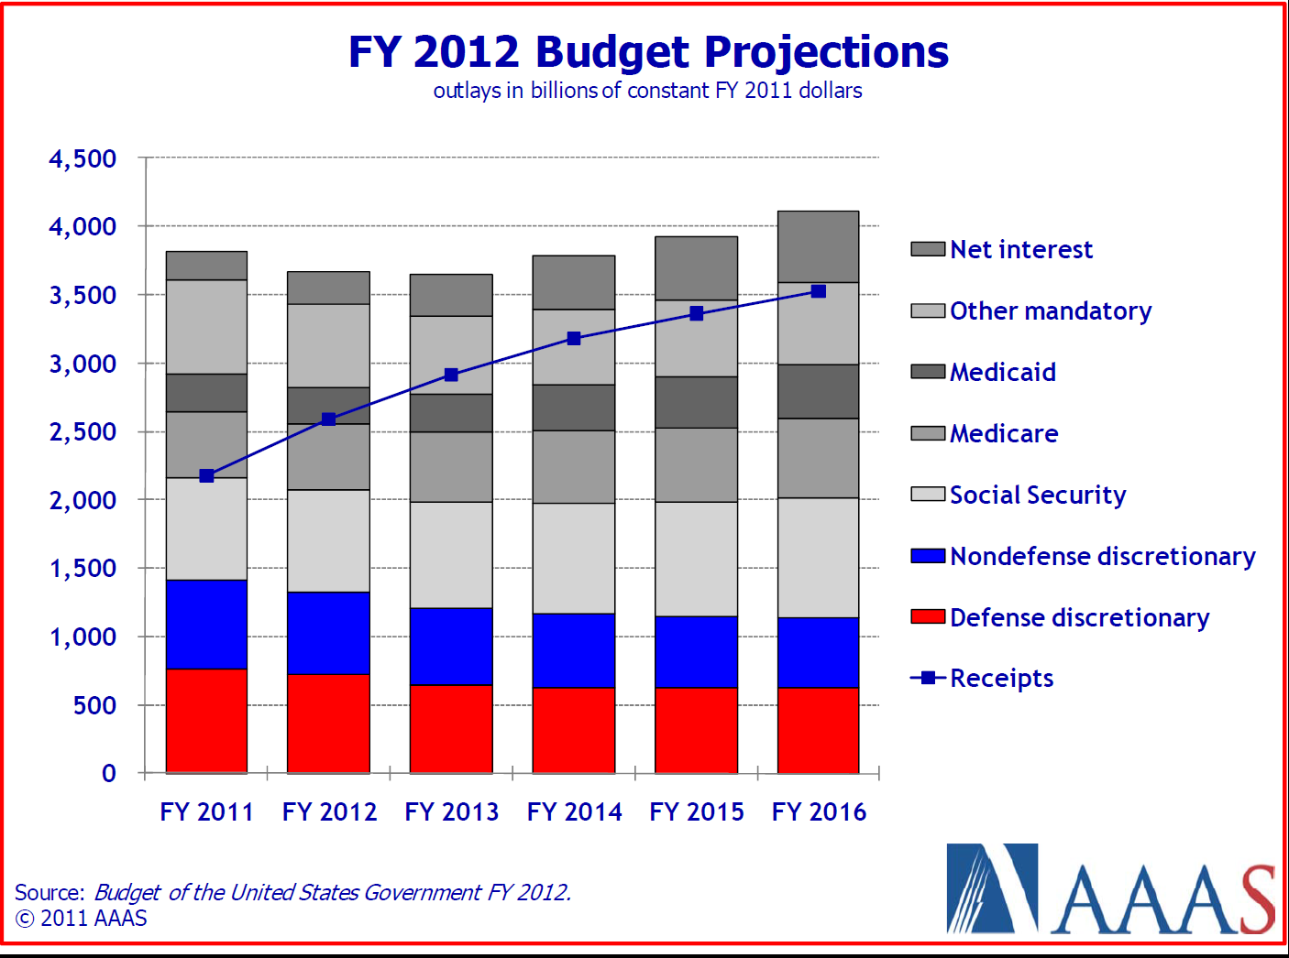

Slide 54
Historical R&D Priorities
(obligations, in 1996 constant dollars)
30%
Energy
25%
Space
20%
15%
Average Annual Increases
10%
All
Defense
Others
Health
5%
All
All
All
0%
Others
Others
Others
-5%
1962 - 1968
1973 - 1979
1979 - 1985
1995 - 2001
Source: National Science Foundation

Slide 55
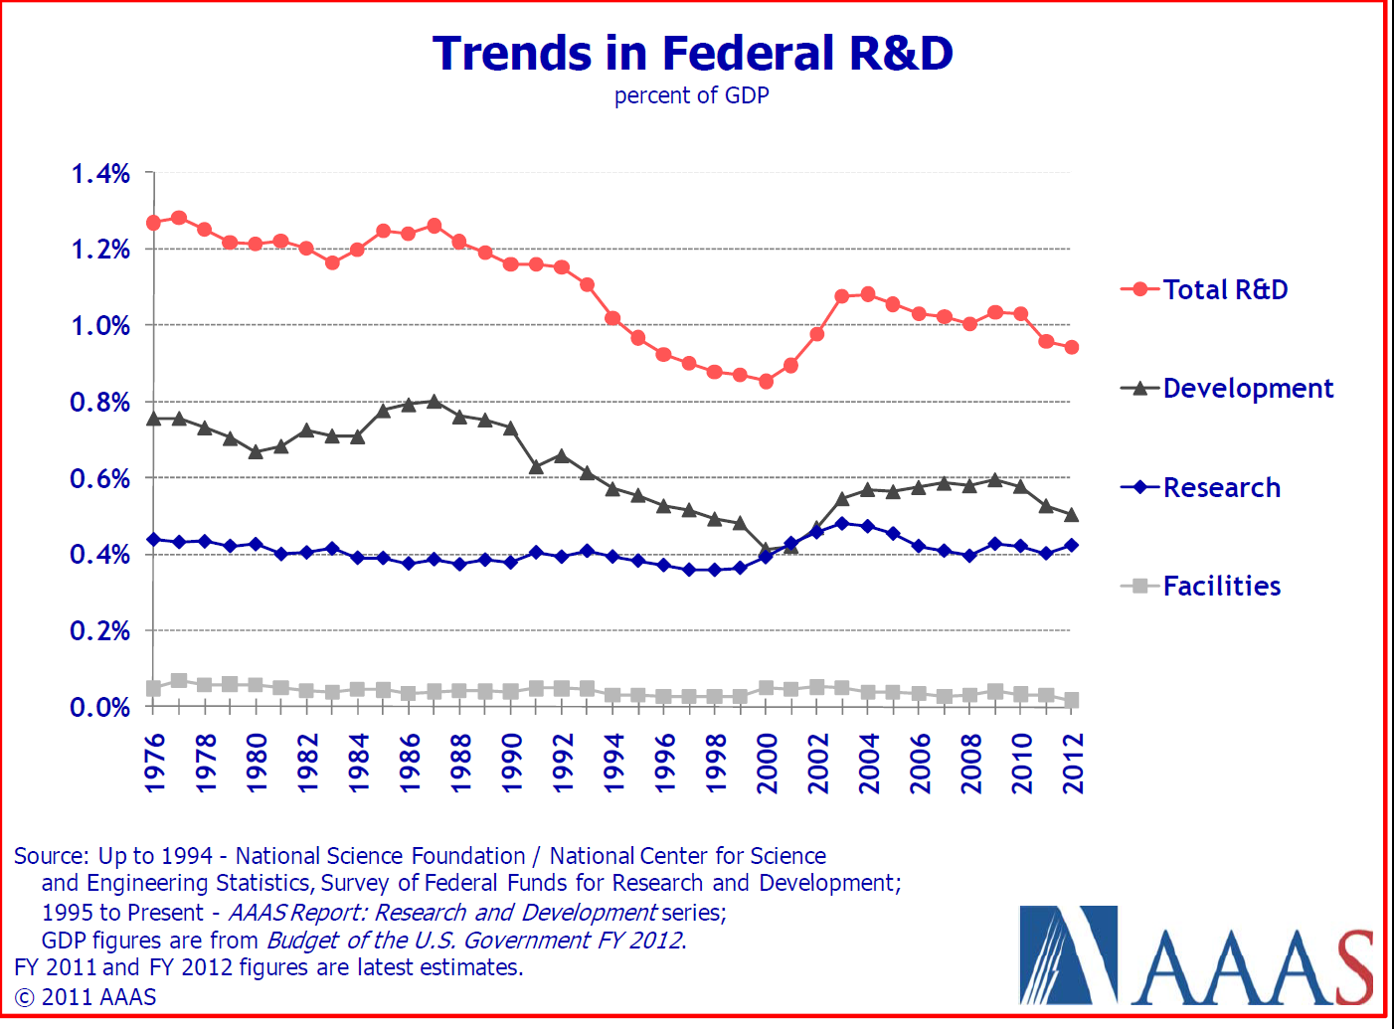

Slide 56
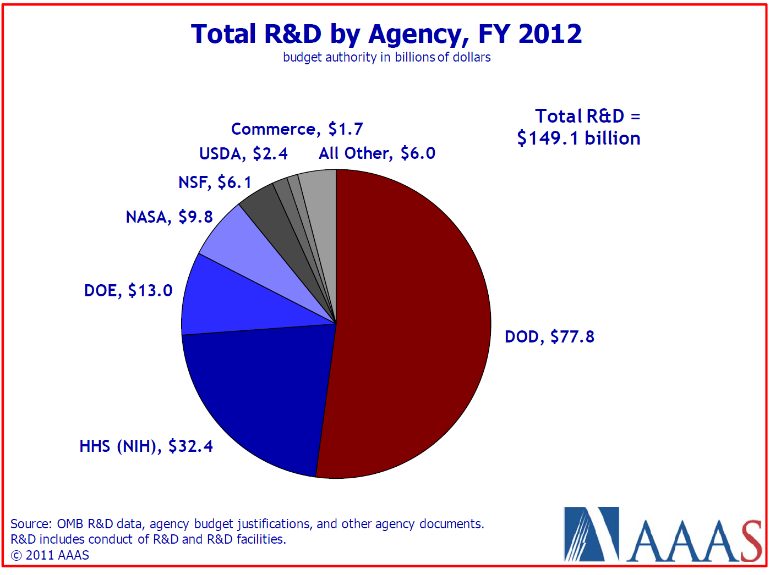
Federal R&D is spread over more than 2 dozen agencies, but DOD (52%) and DHHS (22%) control 3/4ths of it!

Slide 57
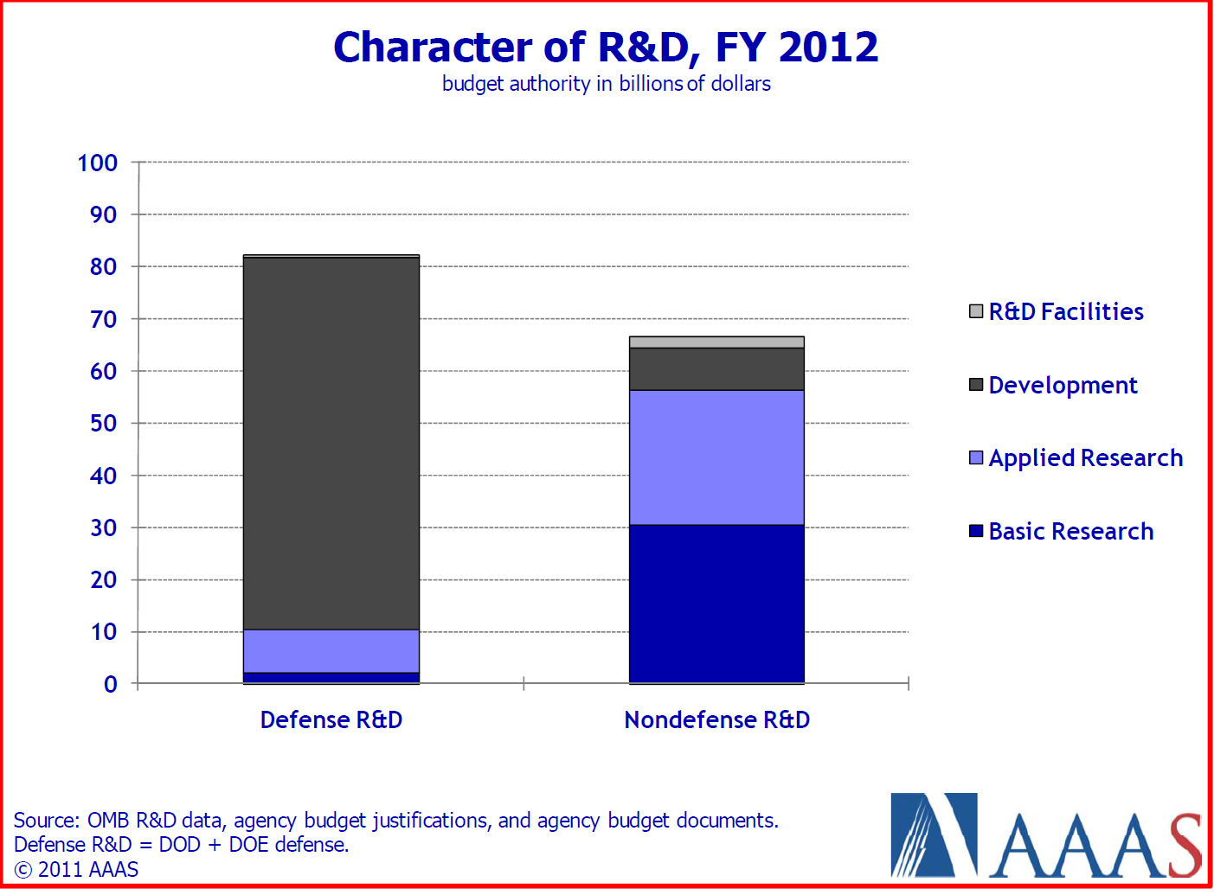

Slide 58
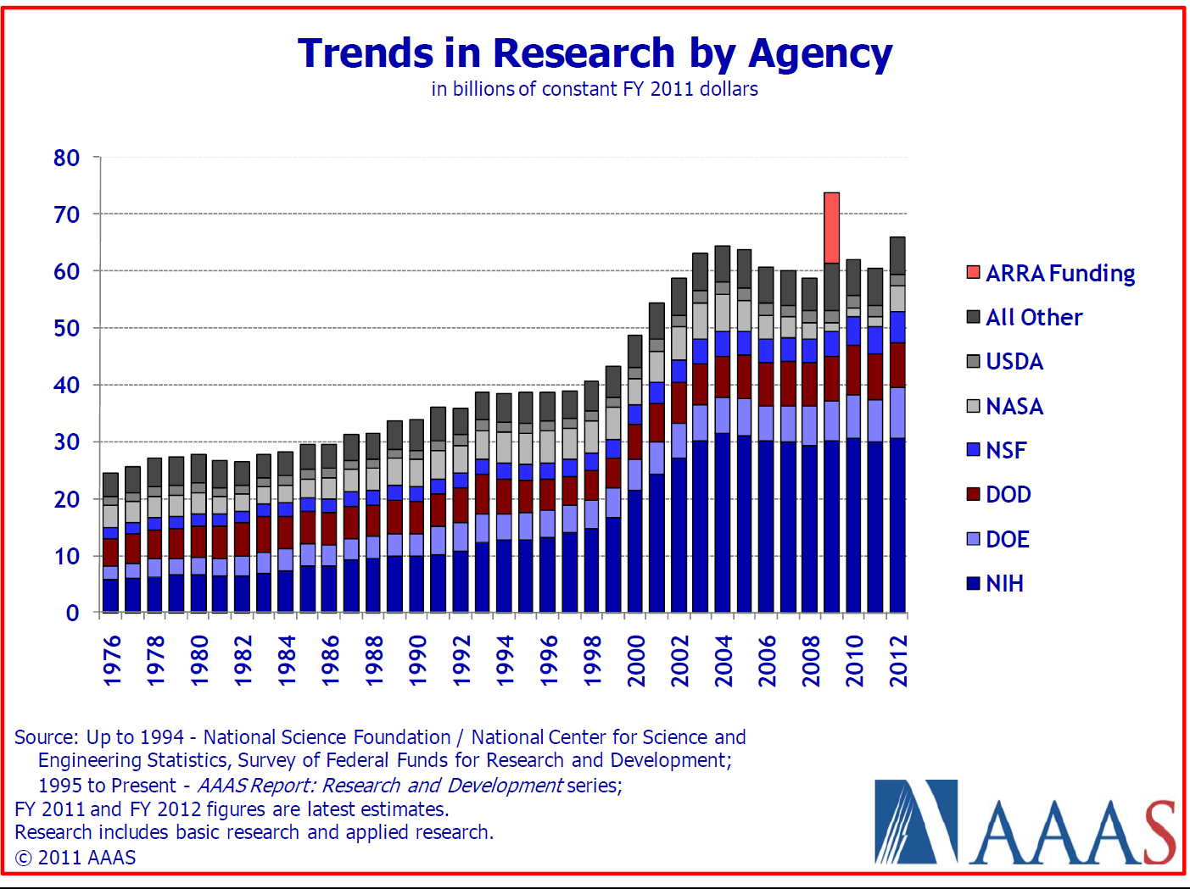

Slide 59
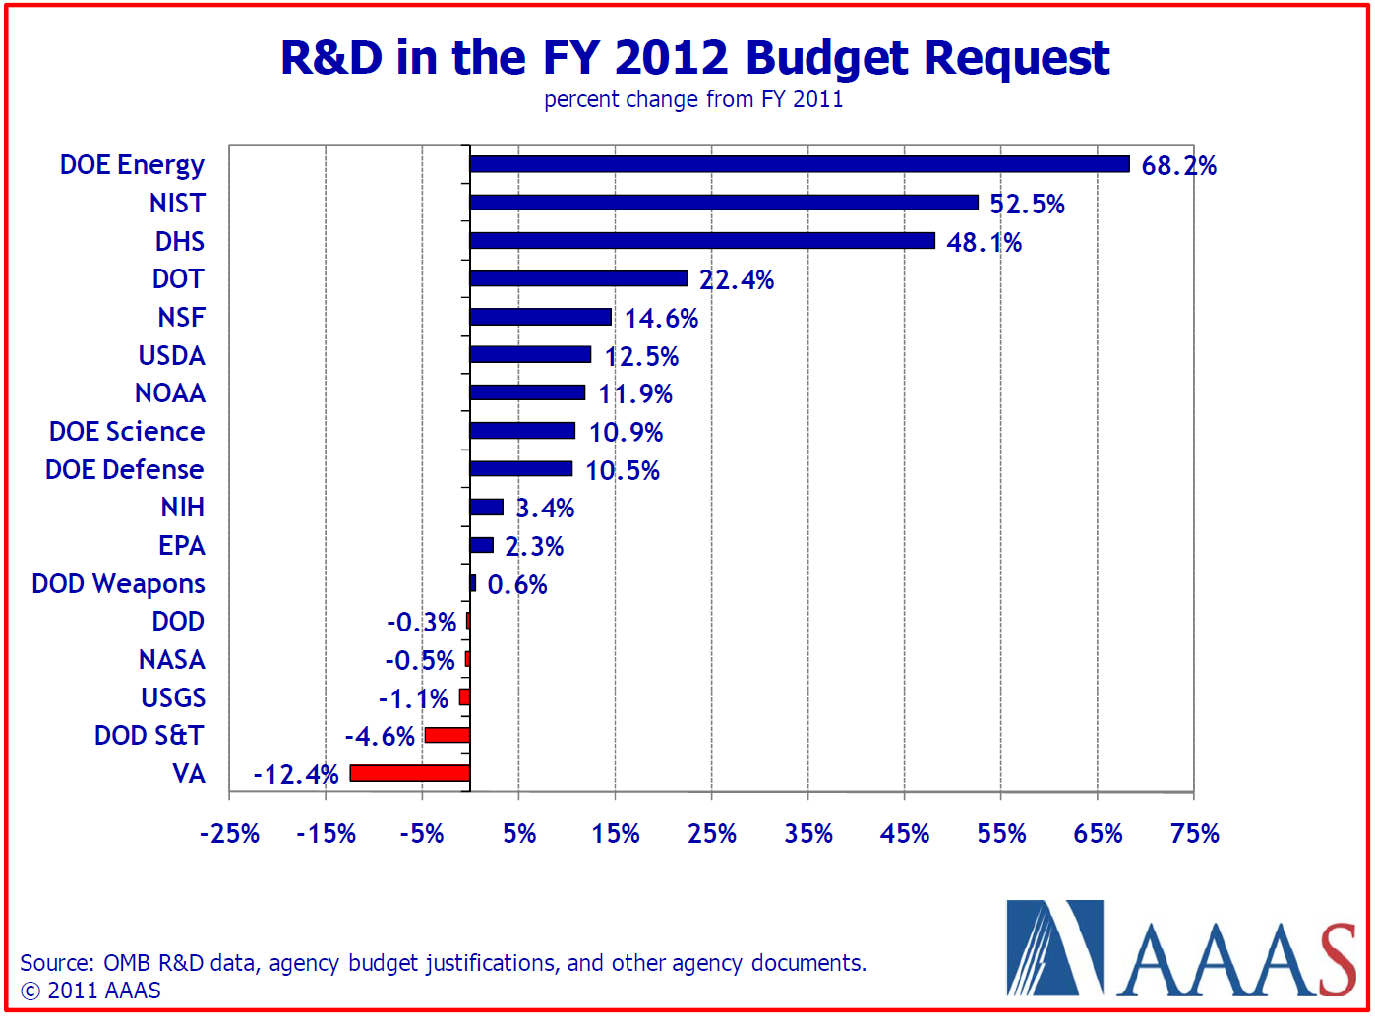

Slide 60
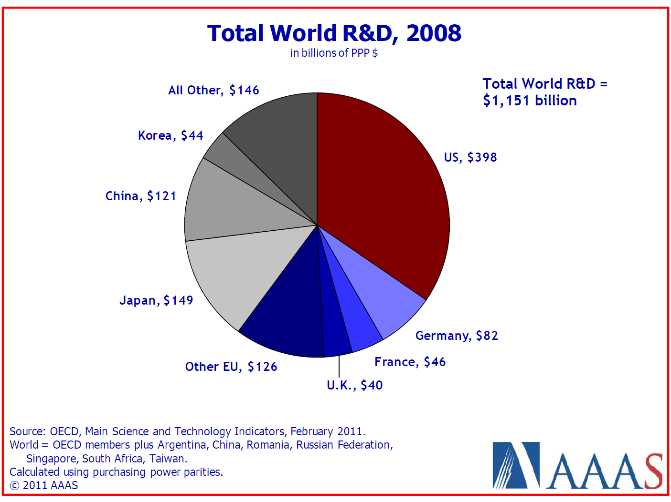

Slide 61
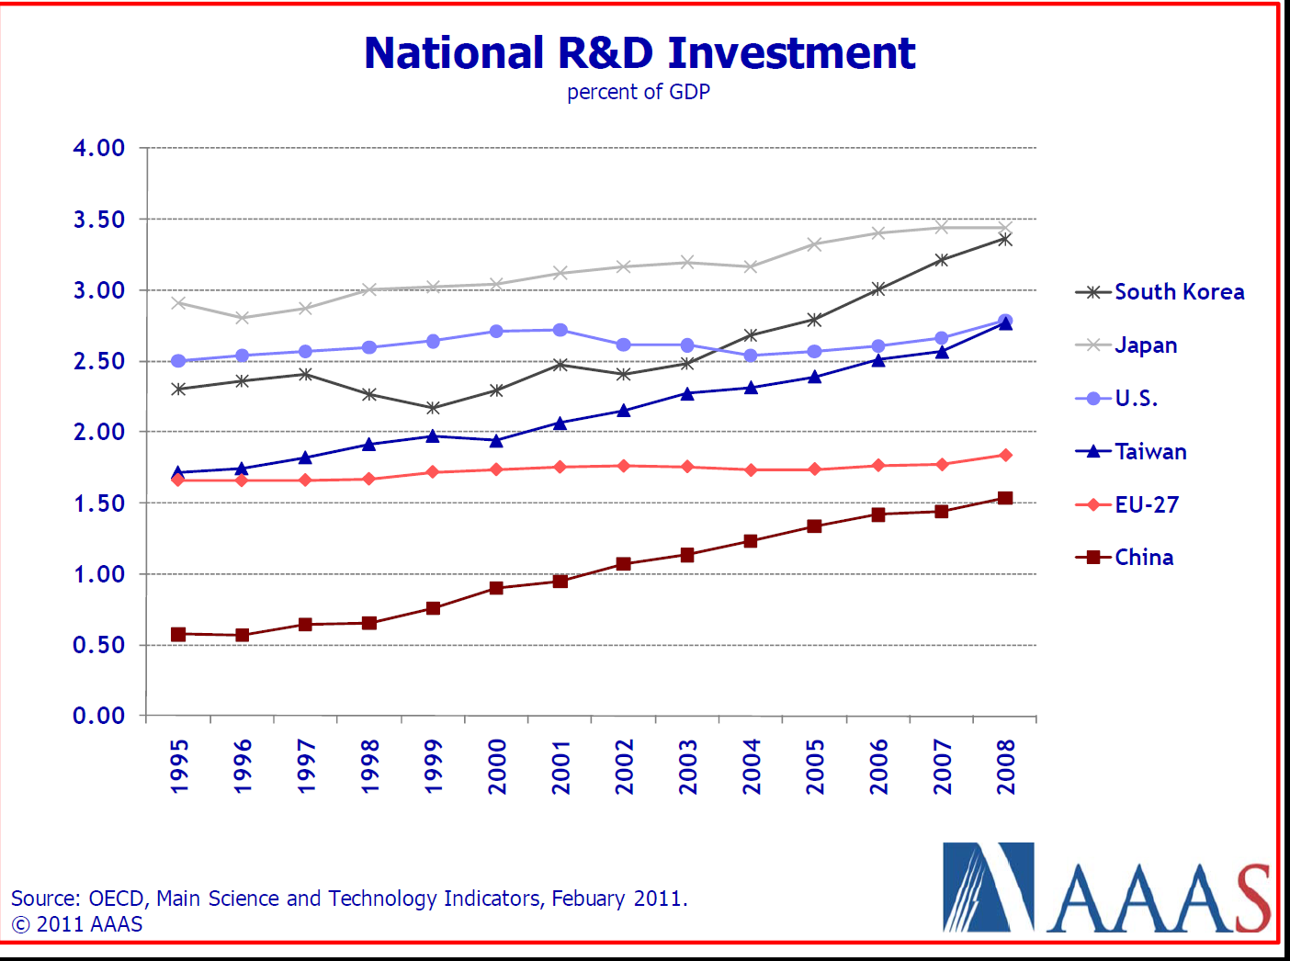

Slide 62
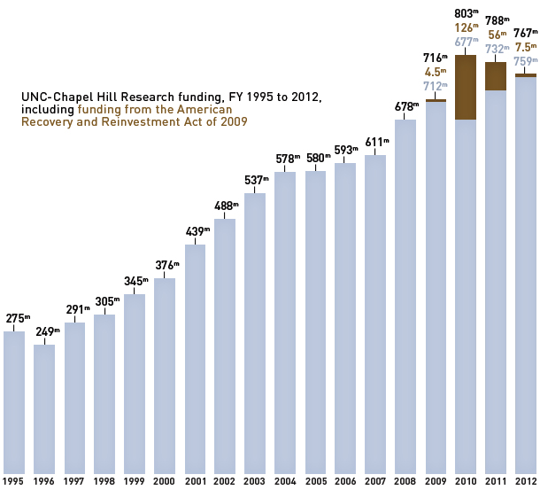
UNC-CH Research Funding: 1995-2112

Slide 63
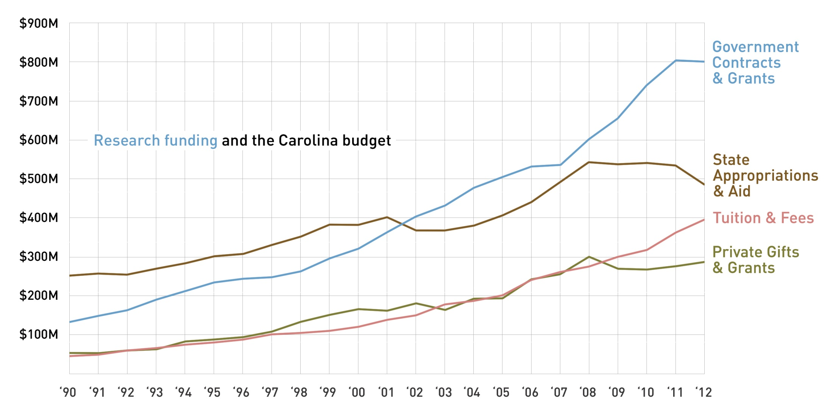
Research Funding and the UNC-CH Budget

Slide 64
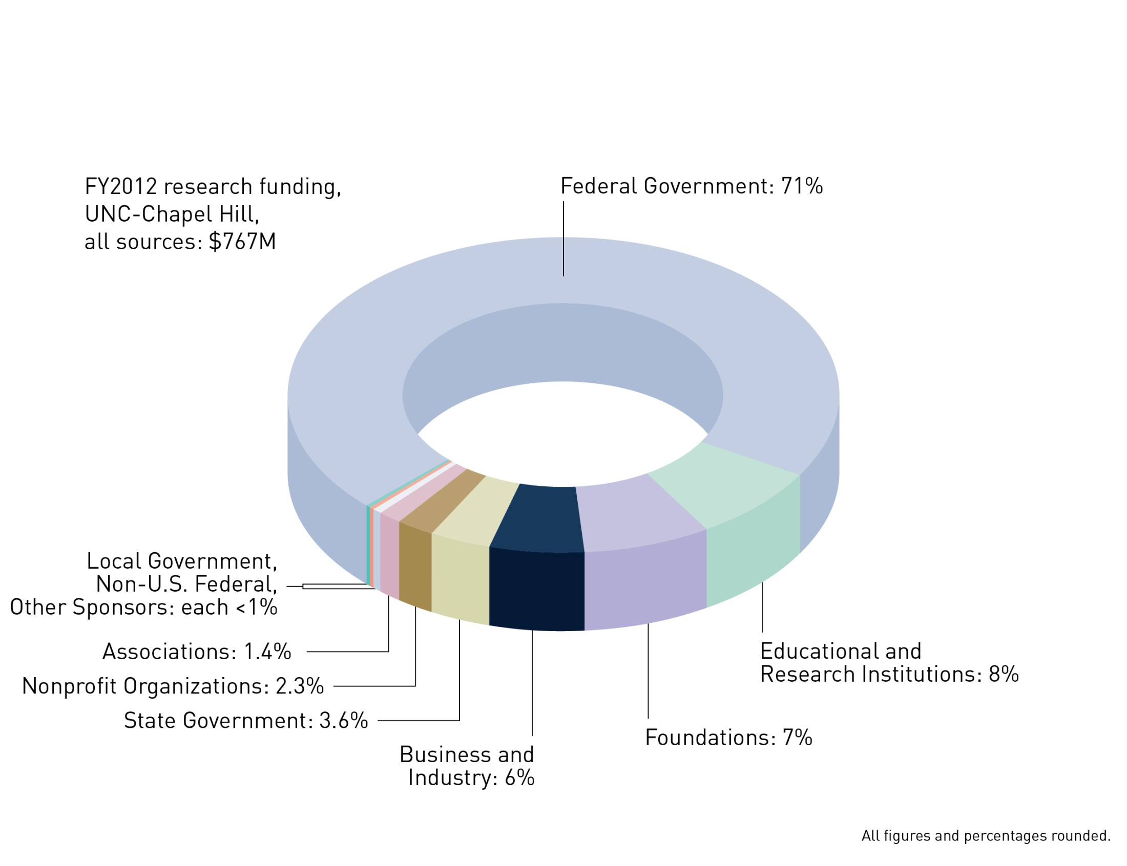
Research Funding by Source for FY2012

Slide 65
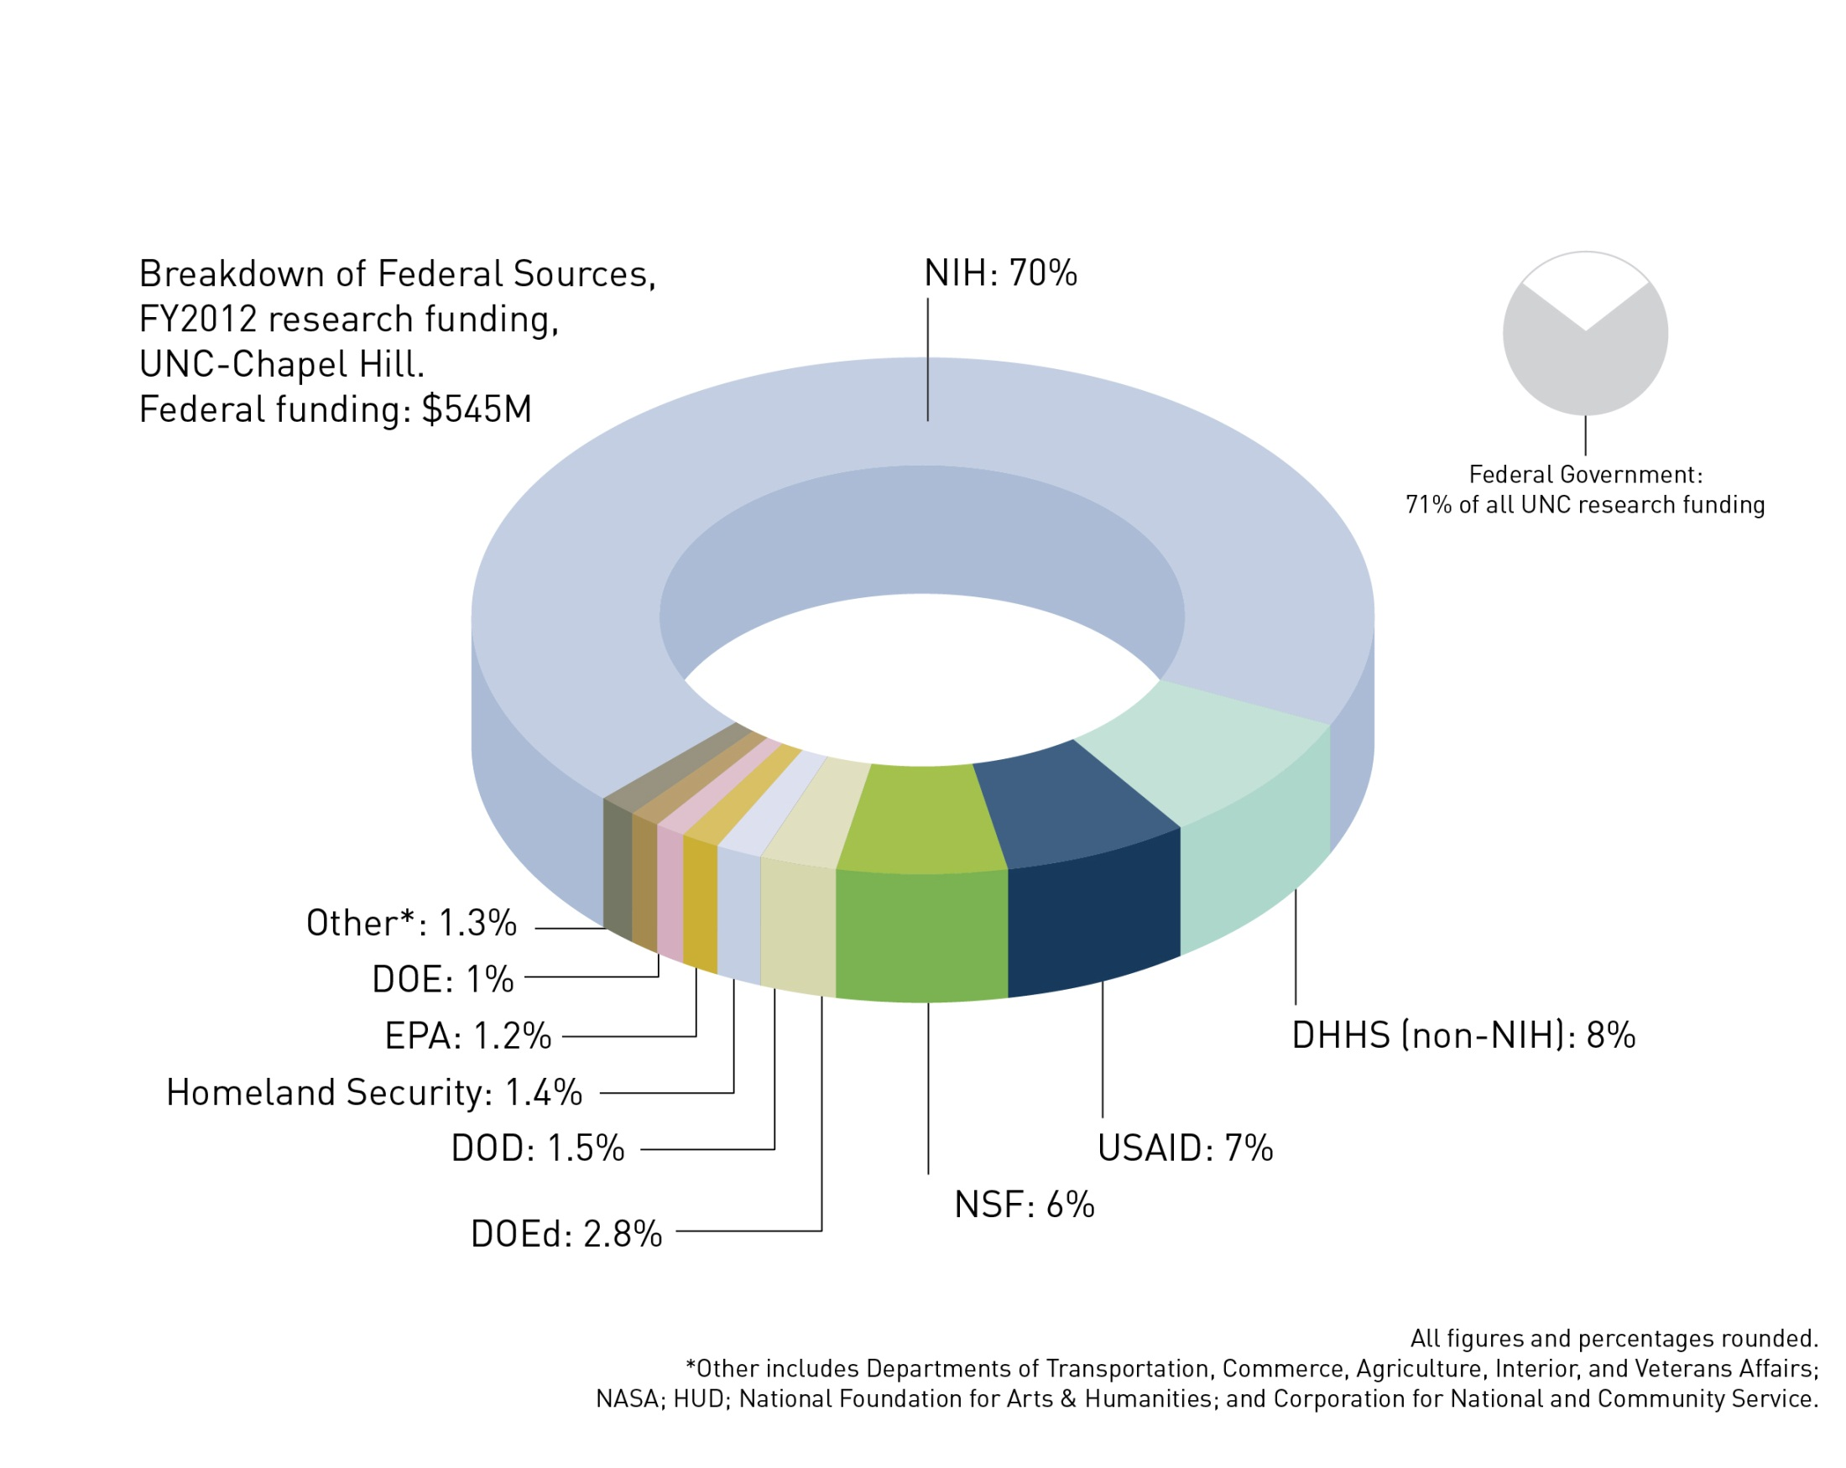
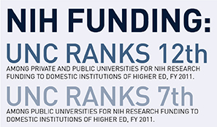
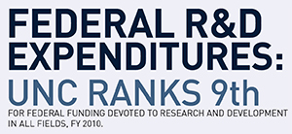
Federal Research Funding by Agency for FY2012

Slide 66
Remember
“There is no law that requires you to take money from the Government to support your research
but once you do, there are many laws you must follow!”
The Golden Rule: He who has the gold, makes the rules!
We’ll be examining these rules in detail over the next few weeks!

